Slide 1
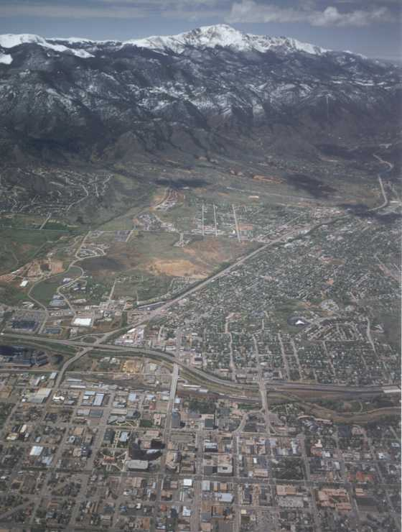
Colorado Springs Utilities
Delivering Work Across Multiple Delivery Platforms
CH2M HILL Alumni Retreat
October 2, 2013

Slide 2
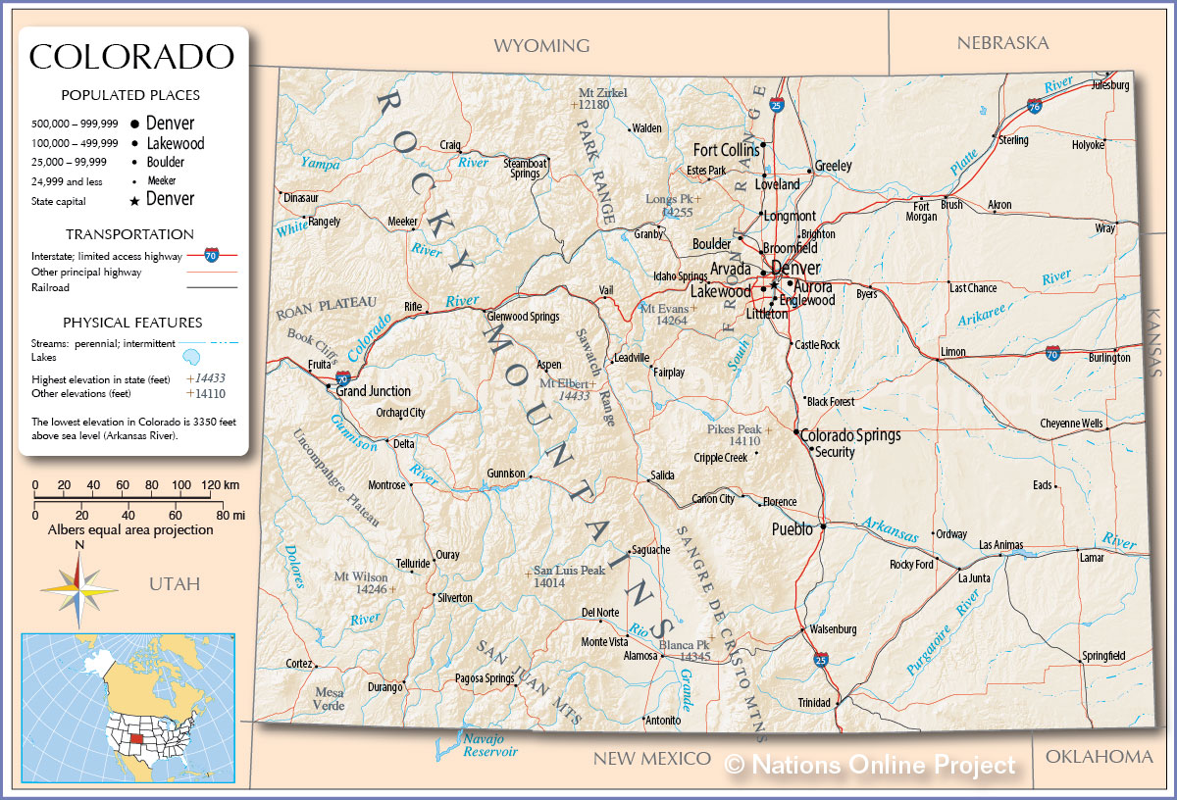
Colorado Springs, CO
70 miles south of Denver
Colorado’s 2nd largest City
(pop: 431,800)

Slide 3
Colorado Springs Utilities (CSU)
$1+ Billion/year City Enterprise
Citizen Owned; City Council serves as Utilities Board
440,000 customers; provides utility service for:
  Water (2012 ADD: 76 MGD)
  Wastewater
  Natural Gas
  Electric
$300+ Million 2013 Capital Budget
  $175 M for Water (including $132 M for SDS)

Slide 4
CH2M HILL’s Path to becoming CSU’s Consultant of Choice
Responsive Action
Creative Solutions
Willingness to Take Risks
Understanding Client Needs
Follow-On Work
Sole-source Projects
Influences Competitive Procurements
Establish
Client
Trust
Consultant of Choice

Slide 5
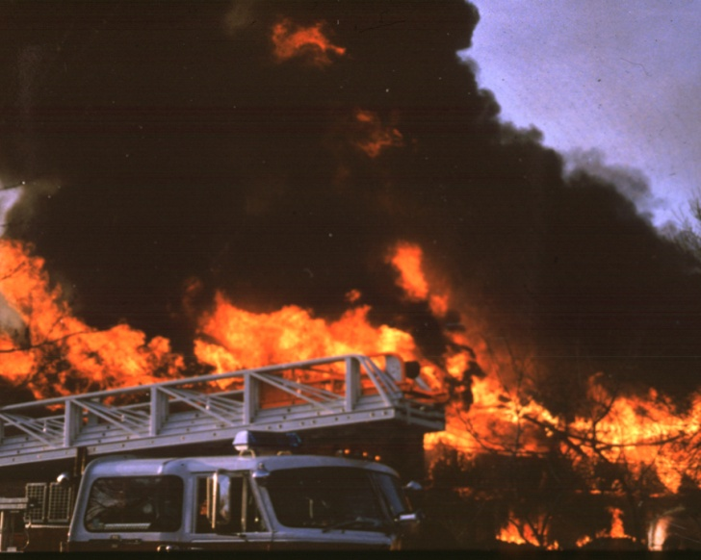
Colorado Springs Office (COS)
The Early Days
Office opened in 1986 (2 staff)
Black & Veatch entrenched as CSU’s primary consultant
Early projects begin to make inroads
  Bruce Spiller transfers to COS
  Win Fire Flow Improvements Study (1993-1994)
  Highly visible project within CSU
  Successful performance leads to . . .

Slide 6
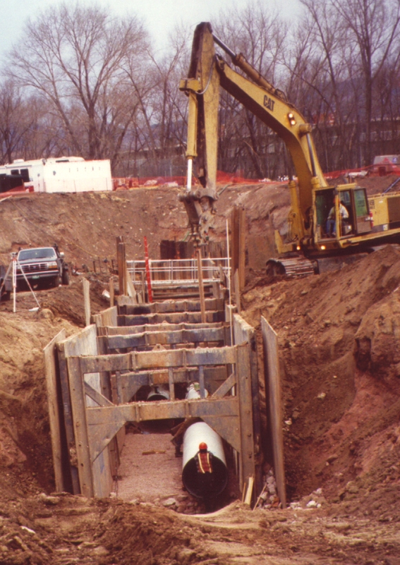
Colorado Springs Office (COS)
The Early Days
Southwest Water Project 1994-96
  First major pipeline design project not done by Black & Veatch in years
  3 segments divided amongst CH2M HILL, Brown & Caldwell, and MWH
  In a challenging urban environment, CH2M HILL outperforms MWH and B&C
  This leads to . . .

Slide 7
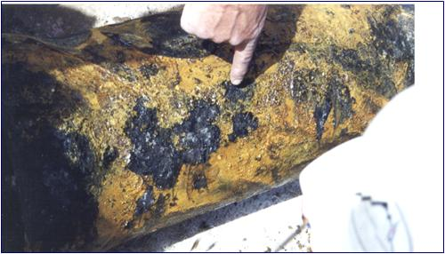
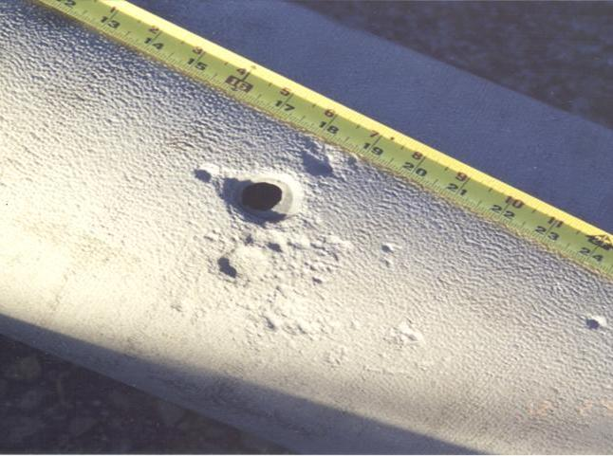
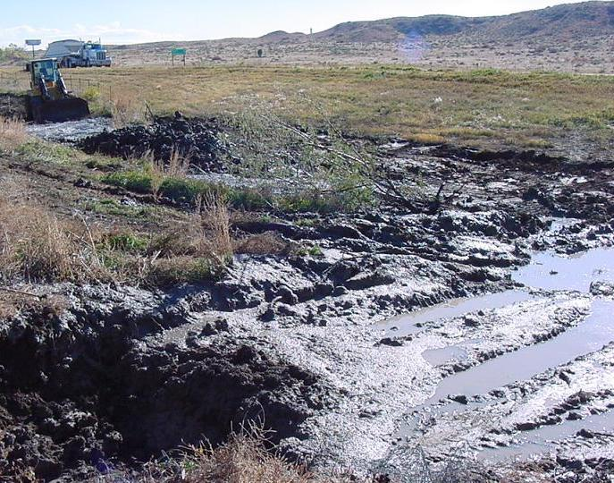
Clear Spring Ranch Sludge Pipeline Replacement Project (1997-2005)
Began with forensic study in 1997
What was causing repeated leaks of sludge?

Slide 8
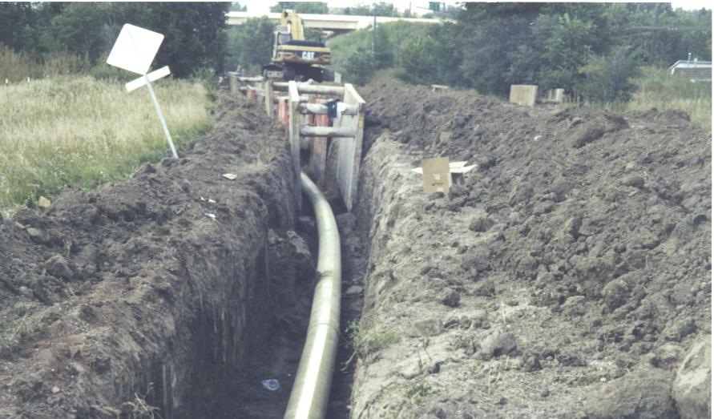
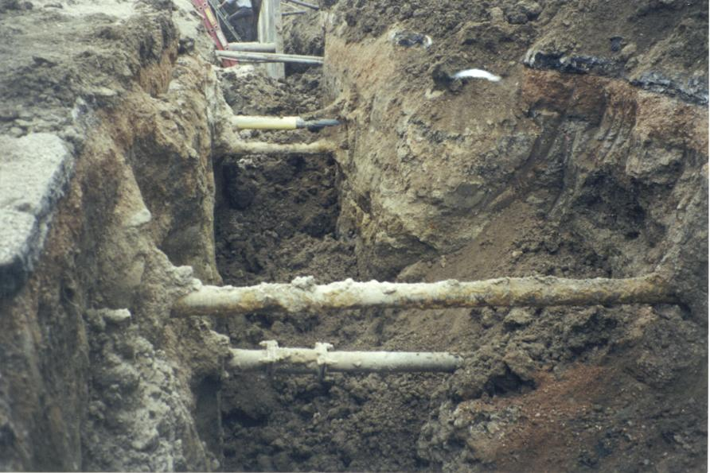
Clear Spring Ranch Sludge Pipeline Replacement Project
Creative Solutions
Understanding Client Needs

Slide 9
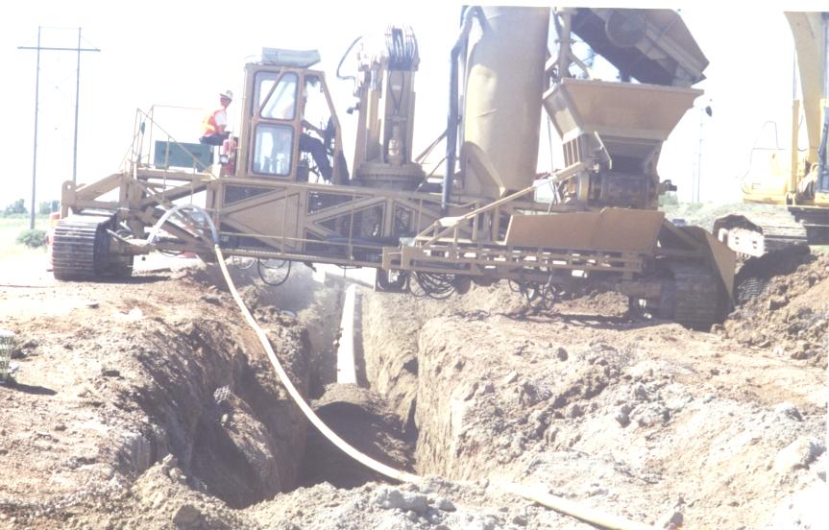
Clear Spring Ranch Sludge Pipeline Replacement Project
Creative Solutions
First Design-Build for CSU; one of the first for WBG

Slide 10
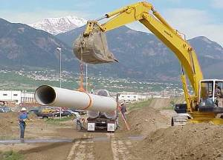
Doors Open Wide
Answering a late night phone call and springing to action the next day leads to . . .
  Fountain Valley Authority (FVA) Pipeline Rehabilitation
    5+ miles of re-aligned 33-in diameter welded steel pipeline
    $7.5 M Design-build delivery completed in 8 months
    Used steel coil already on-hand
    at Northwest Pipe to start
    fabrication while still in design
    phase.

Slide 11
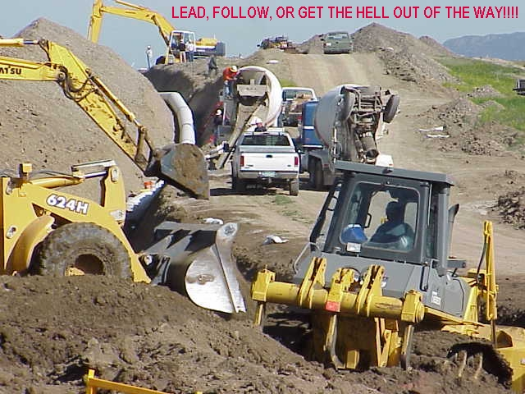

Slide 12
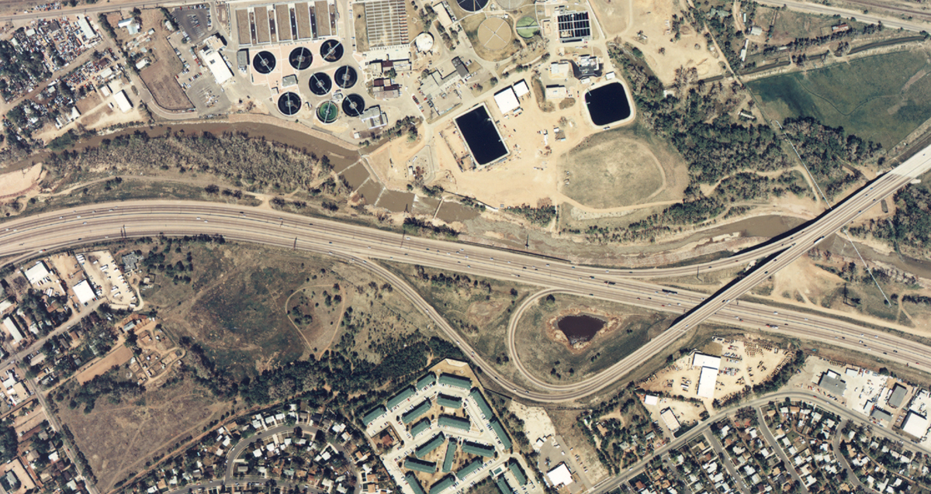
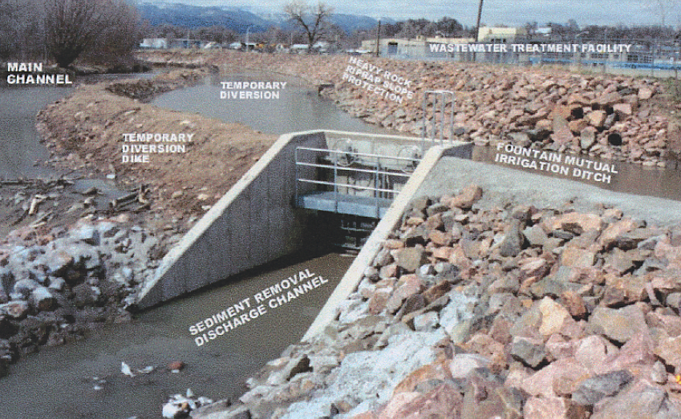
Las Vegas WWTP Emergency Streambank Restoration
Trust, responsiveness, aggressive & creative approaches, and
on-site presence leads to $2.3M emergency DB project.
Sole Sourced
CH2M HILL becoming
the “Can-do” consultant
of choice for CSU

Slide 13
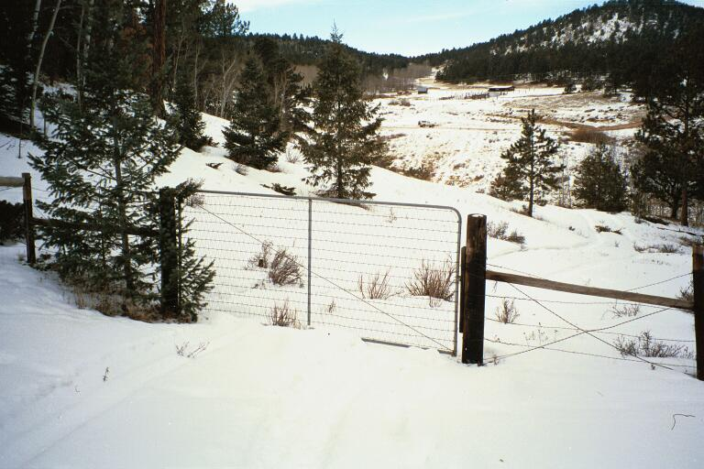
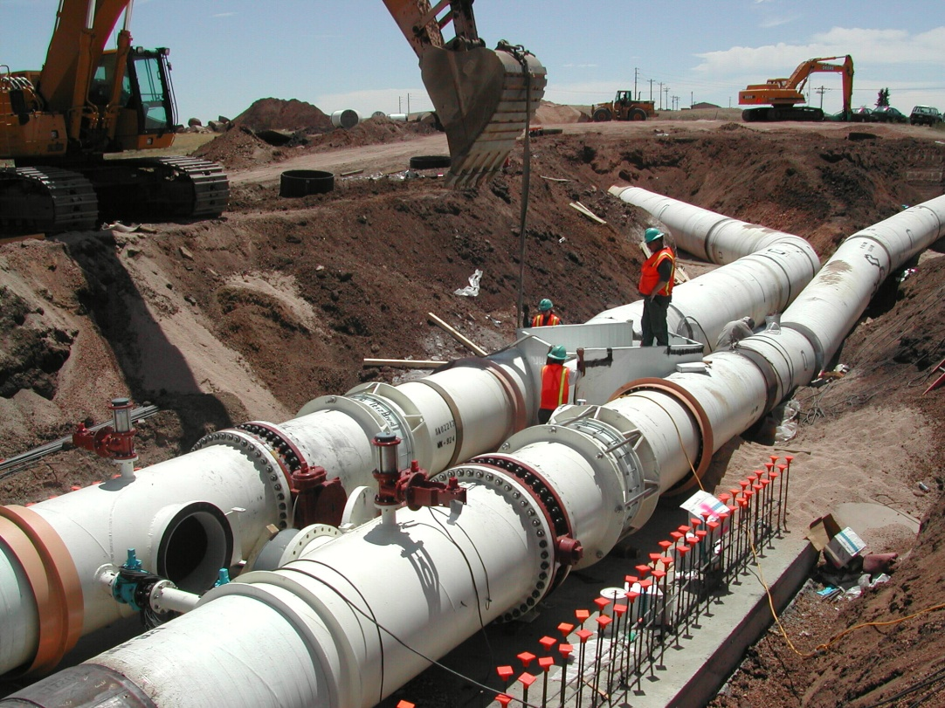
Competitive Wins Influenced by Relationships Built on
Performance and Trust
Lower Homestake Parallel Pipeline - $1.7 M (Design/SDC)

Slide 14
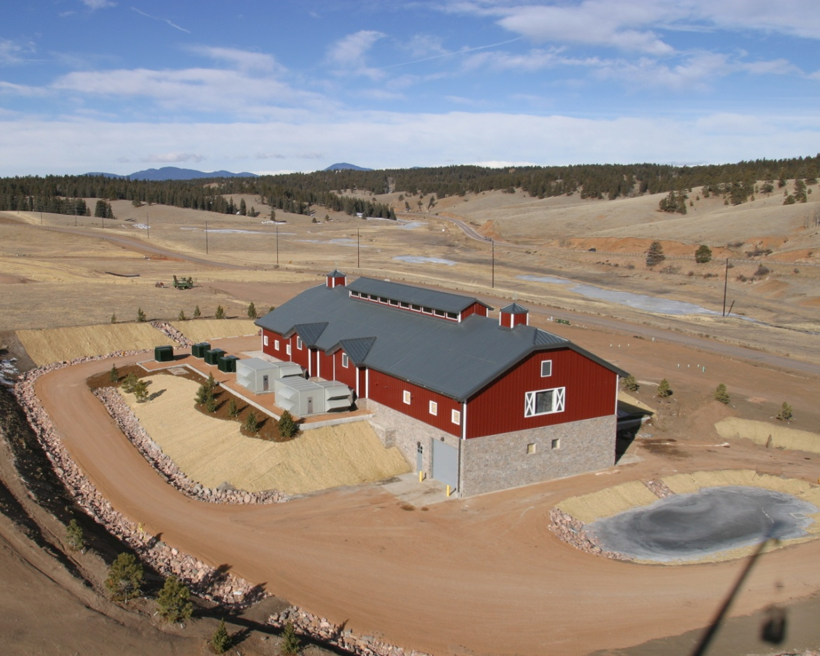
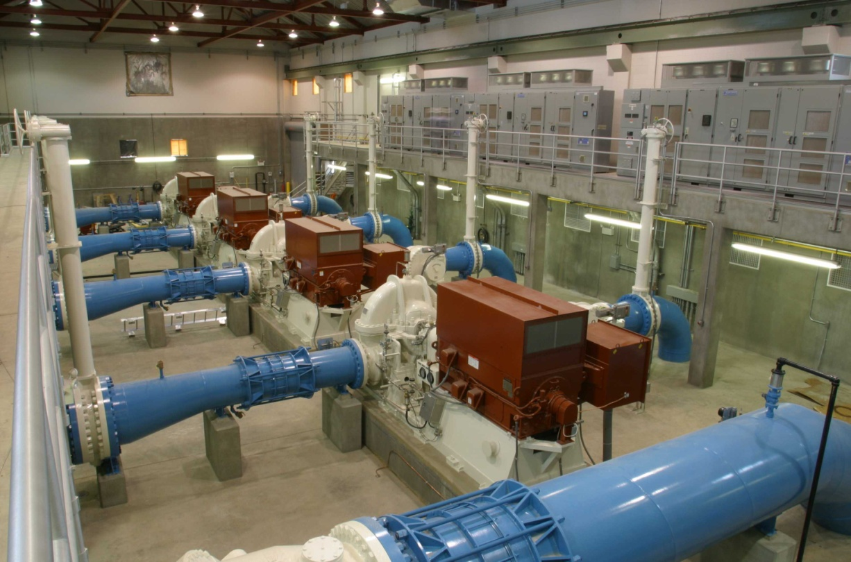
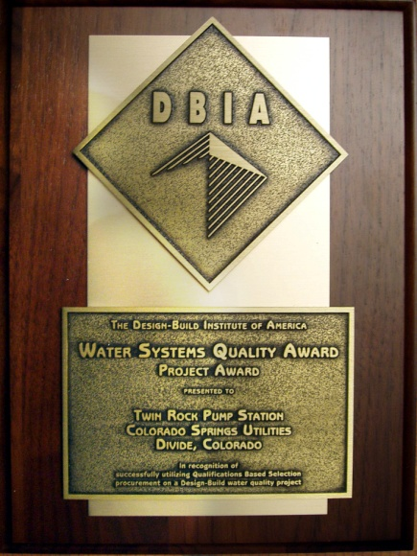
Competitive Wins Influenced by Relationships Built on
Performance and Trust
Twin Rock Pump Station - $13.9 M (DB – Self-perform)

Slide 15
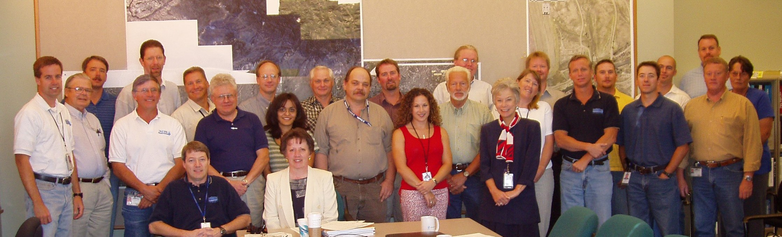
The Big Prize!!
Southern Delivery System (SDS)
Initial Task Order for <$500K signed June, 2002
Eleven years later . . .
  24 task orders; more than 100 amendments expanding their scope.
  Flywheel project for COS office that fueled growth in GeoSpatial TBG, and GF&I Business Groups.
  Office grows from 6 staff in 1999 to 70+ by 2008

Slide 16
The Big Prize!!
Southern Delivery System (SDS)
78 MGD Water Supply Project to meet Colorado Springs water needs through 2046 and beyond
Includes:
  46 miles of 60-in to 90-in transmission pipeline.
  Three in-line raw water pump stations.
  Water Treatment Plant and Treated Water Pump Station
  Upstream connection to Pueblo Dam & Reservoir
  Raw water storage reservoir
CH2M HILL provided:
  Planning and preliminary design for all elements of SDS
  Final design of the 11 raw water transmission pipeline segments and the Pueblo Dam connection

Slide 17
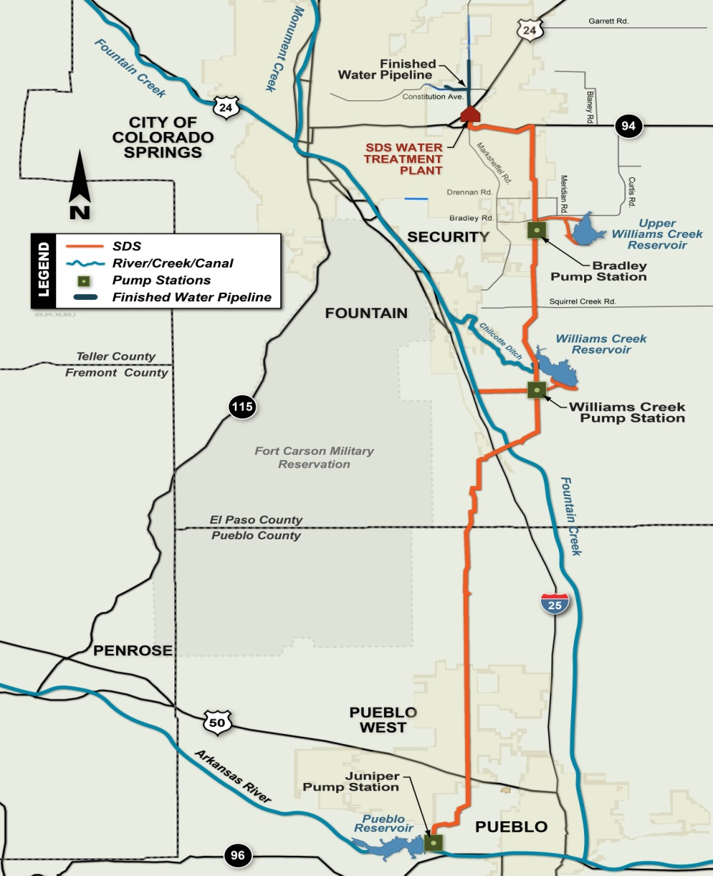
The Big Prize!!
Southern Delivery System (SDS)
PJTD:
  1,089 staff
  481,121 hours
  $81.5 million contract value
  (98% invoiced to date)
SDS Raw Water
Transmission Pipeline

Slide 18
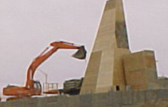

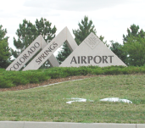
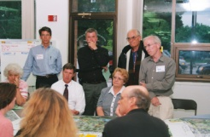
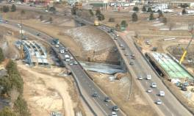
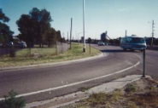

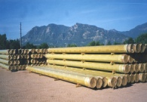
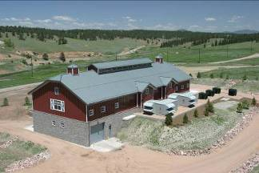
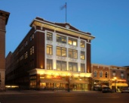

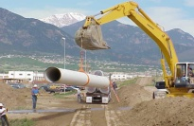

Success Breeds Success Across BGs
I-25/US50/SH 47
Austin Bluffs/ Union
Colorado Springs Airport Business Park
South Metro Accessibility
New Pueblo Freeway EIS
COSMIX
1986
1993
1995
1997
2000
2001
2002
2003
2004
2005
2006
2007
LVWWTF Tertiary Exp.
Academy/Galley PRV
Upper Homestake CA
Gen. Engineering On-Call
Fountain Creek Recovery
LVWWTF Headworks
Portal Park Pump Station
and others
$27 million
S1 million
$5 million
30+ projects
$10 million
$4 million
$0.5 million
Design-Build
Design-Build
Study/Design
All Services
Design-Build
Design-Build
Design/SDC
Fire Flow
Improvements
Sludge Pipeline
Replacement
Twin Rock
Pump Station
COS Opens
Fountain Valley
Pipeline
Southern Delivery System
Southwest Water

Slide 19
CH2M HILL’s Path to becoming CSU’s Consultant of Choice
Responsive Action
Creative Solutions
Willingness to Take Risks
Understanding Client Needs
Follow-On Work
Sole-source Projects
Influences Competitive Procurements
Establish
Client
Trust
Consultant of Choice

Slide 20
CH2M HILL’s Ultimate Success is
Built on Our People
Good people win projects
Responsive service
delivers good projects
Good projects
add people

Slide 21
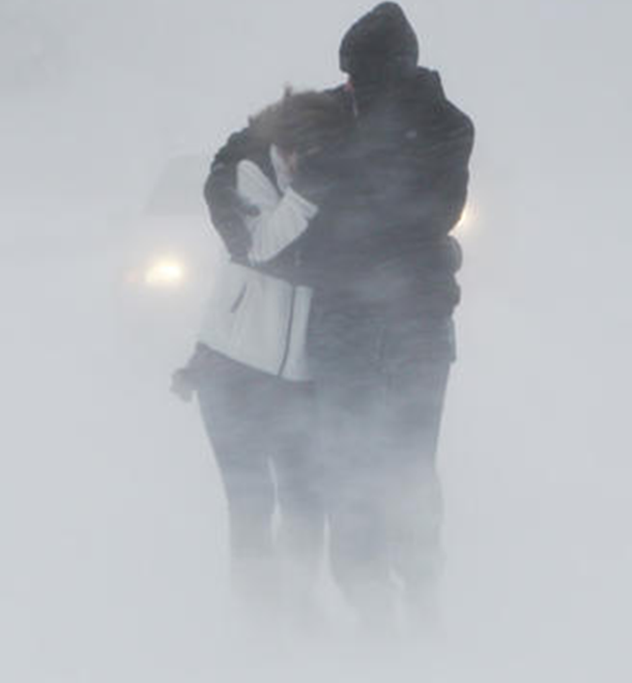
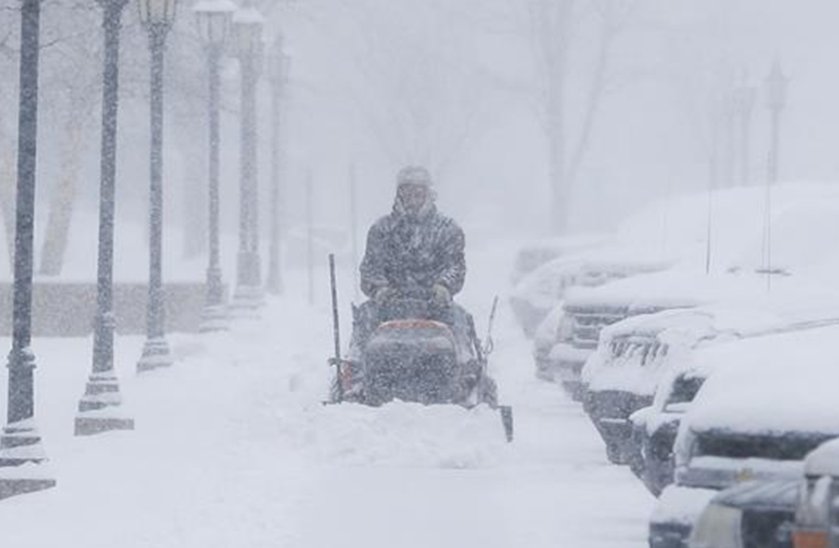
Spiller’s Reward for COS Success
Assignment: Fargo

